Slide 1

TnT: A File System Synchronizer
Justin
Zach
Pritish
Deepak
Holmgren
Kabelac
Kamath
Vasisht

Slide 2



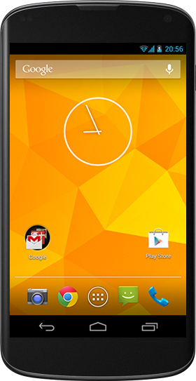

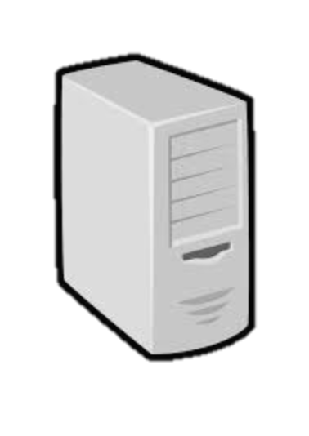
Distributed File Synchronizer

Slide 3
Problem Statement
What do we seek?
No restriction on sync patterns
No false conflicts
No meta-data for deleted files
Network usage: proportional to changed files
Allow partial syncs within file system

Slide 4
Design of Tra
Vector Time Pairs
Modification histories
Sync histories
Creation Times
Start Sync
Do you have any changes that I don’t know about?
No
Do Nothing
Yes
Do I have any changes that you don’t know about?
No
Update
Yes
Conflict

Slide 5
System Design
File System Watcher
inotify go-linux package
Raises interrupts on File System changes
Meta-data is always up-to-date!
Failure Recovery
On Sync : 2-phase-commit style
Sync, and store new files in tmp
Log updated meta-data to disk
Move files from tmp to appropriate locations
On Start up
Apply unfinished changes
Look at time stamps to detect new changes

Slide 6
TnT Evaluation
Correctness Testing
100K random system updates across 5 machines
Plot of metadata overhead vs. created files

Slide 7

Thank You!
TnT’s not Tra
Special thanks to Russ Cox for helping us out with a technical doubt in Tra!

